Slide 1
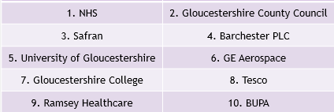
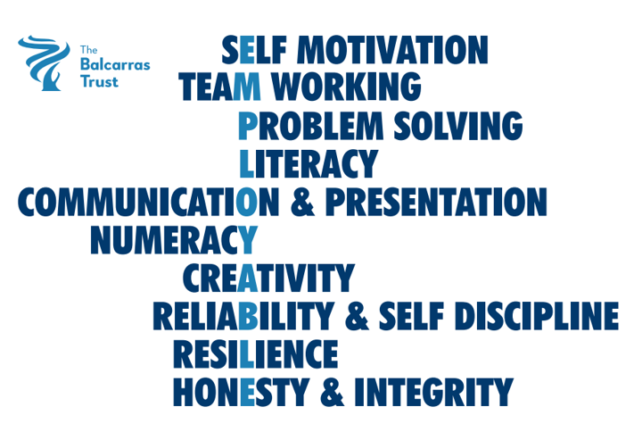
LMI Gloucestershire – January 2025 (source: Glos County Council)
Number of Unemployed:
10670 ↑295
2.7% population aged 16-64
Job adverts:
15453 ↑1527
↑11% in Gloucestershire, ↑ 9.4% in whole UK
Top common skills mentioned in job adverts
What occupations are most advertised?
Top occupations | Adverts | % of adverts
Care workers & home carers | 628 | 4.1
Sales Related | 447 | 2.9
Cleaners & domestics | 447 | 2.9
Programmers & software developers | 311 | 2.0
Teaching assistants | 291 | 1.9
Managers in wholesale & retail | 283 | 1.8
Customer service | 264 | 1.7
Kitchen & catering assistants | 250 | 1.6
Customer service | 242 | 1.6
Plant & machine operatives | 236 | 1.5
General occupation | Adverts
Professional (eg engineer, scientist, teacher, doctor, accountant, actor) | 3864
Associate professional & technical (eg midwife, police, engineering technician) | 2275
Elementary (eg cleaner, caretaker, labourer) | 1768
Caring & leisure | 1417
Top ten companies hiring

