Slide 1
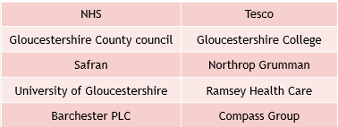
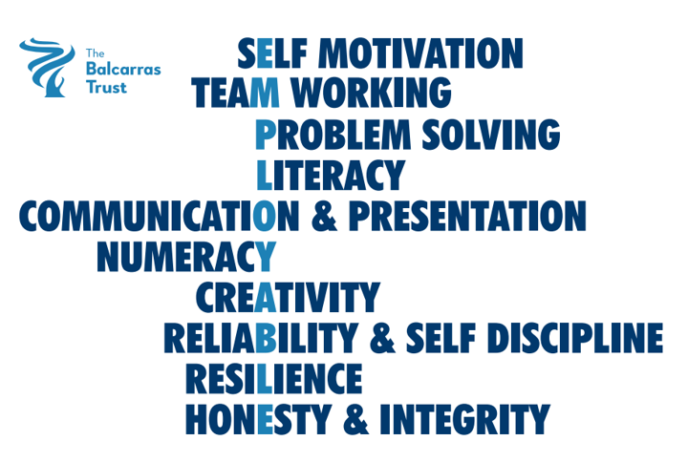
LMI Gloucestershire – December 2024 (source: Glos County Council)
Number of Unemployed:
10560 ↓30
2.7% population aged 16-64
Job adverts:
13704 ↓241
↓5.5% in Gloucestershire, ↓5.5% in whole UK
Top skills mentioned in job adverts
Common skills
Specialised skills
Two skills are related to finance
What occupations are most advertised?
Top occupations | Adverts
Sales and retail | 660
Care workers & home carers | 542
Cleaners & domestics | 390
Programmers & software developers | 279
Other administrative | 257
Teaching assistants | 253
Kitchen & catering assistants | 236
Chefs | 230
Customer service | 207
General occupation | Adverts
Professional (eg engineer, scientist, teacher, doctor, accountant, actor) | 4652
Associate professional & technical (eg midwife, police, engineering technician) | 2531
Elementary (eg cleaner, caretaker, labourer) | 1633
Sales & customer service | 1569
Administerial & secretarial | 1515
Caring & leisure | 1412
Managers, directors & senior officials | 1363
Skilled trade (eg electrician, welder, builder) | 1093
4% of all jobs advertised were for care work
Top ten companies hiring

