Slide 1
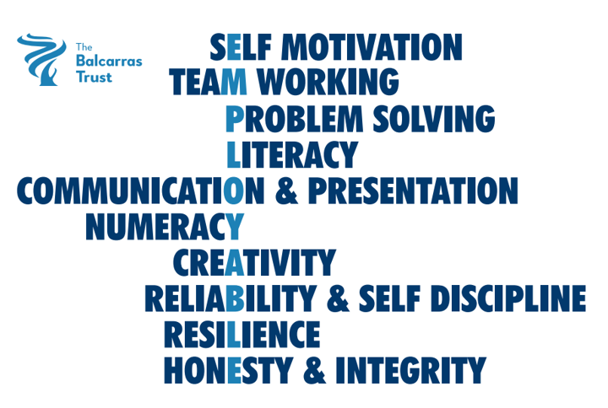
LMI Gloucestershire – April 2025 (source: Glos County Council)
Number of Unemployed:
10660 ↓ 120
2.7% population aged 16-64
Job adverts:
14420 ↓337
↓2.3% in Gloucestershire, ↓1.4% in whole UK
Change in job postings between April 2024 and 2025
What occupations are most advertised?
Top companies hiring
Safran
Tesco
Barchester PLC
Gloucestershire County Council
NHS

