Slide 1
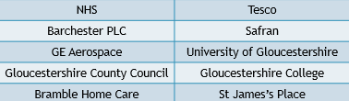
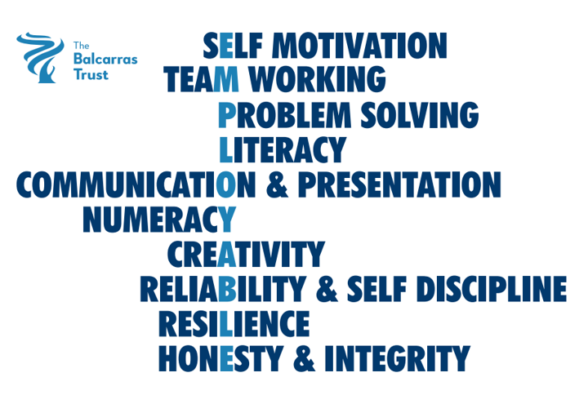
LMI Gloucestershire – November 2024 (source: Glos County Council)
Number of Unemployed:
10590 ↓50
2.7% population aged 16-64
Job adverts:
14539 ↓241
↓1.7% in Gloucestershire, ↓2.4% in whole UK
Top skills mentioned in job adverts
Common skills
Specialised skills
What occupations are most advertised?
General occupation | Adverts
Professional (eg engineer, scientist, teacher, doctor, accountant, actor) | 3327
Associate professional & technical (eg midwife, police, engineering technician) | 2017
Elementary (eg cleaner, caretaker, labourer) | 1935
Sales & customer service | 1357
Caring and leisure | 1298
Administerial & secretarial | 1198
Managers, directors & senior officials | 1182
Skilled trade (eg electrician, welder, builder) | 1140
Top occupations | Adverts
Sales and retail | 686
Cleaners & domestics | 605
Care workers & home carers | 465
Kitchen & catering assistants | 297
Programmers & software developers | 263
Teaching assistants | 259
Customer service | 258
Chefs | 246
Top ten companies hiring

